Slide 1
Can You Live There?
Alex Black, Aaron Isaacson, Michelle Salter, Hannah Tate, Justin Thomas

Slide 2
Project Proposal
Our project examines the relationship between US housing prices and occupations by industry. We will investigate how some industries could be driving housing market prices, what the distribution of jobs by industry looks like in relation to the local housing market, and why an area’s average income correlates with the number of local jobs for specific industries.
Notes:
Motivation & Summary Slide
Define the core message or hypoth of your project
Describe the questions you asked and why you asked them
Describe whether you were able to answer these questions to your satisfaction, and briefly summarize your findings

Slide 3
Data & Questions
Zillow API
Housing market prices data
Department of Labor API
Employment data
Bureau of Labor Statistics
Census API
Employment data
Household income data
So how do we show this?
Are there industries that have higher housing prices?
Is it possibly that those industries have a higher salary or is it that those industries have more jobs and bring more people to those areas?
What is the distribution of industry in the top housing markets?
What does the national data look like?

Slide 4
A little “terminology” before we dive in…
FIPS
Federal Information Processing Series
NIST and ANSI
County-
A county or county equivalence determined to be statistically significant (parish, boroughs, city not-within a county , area not covered by a county)
Industry
NAICS
Census and BLS subsectors
Government vs Private
Notes:
Questions & Data
Elaborate on the questions you asked, describing what kinds of data you needed to answer them, and where you found them

Slide 5
Goods – Producing
Natural Resources & Mining
Construction
Manufacturing
Service – Providing
Trade, Transportation, & Utilities
Information
Financial Activities
Professional & Business Services
Education & Health Services
Leisure & Hospitality
Other
Unclassified
Industry
(NACIS)
Notes:
A breakdown on the industry subsectors by BLS

Slide 6
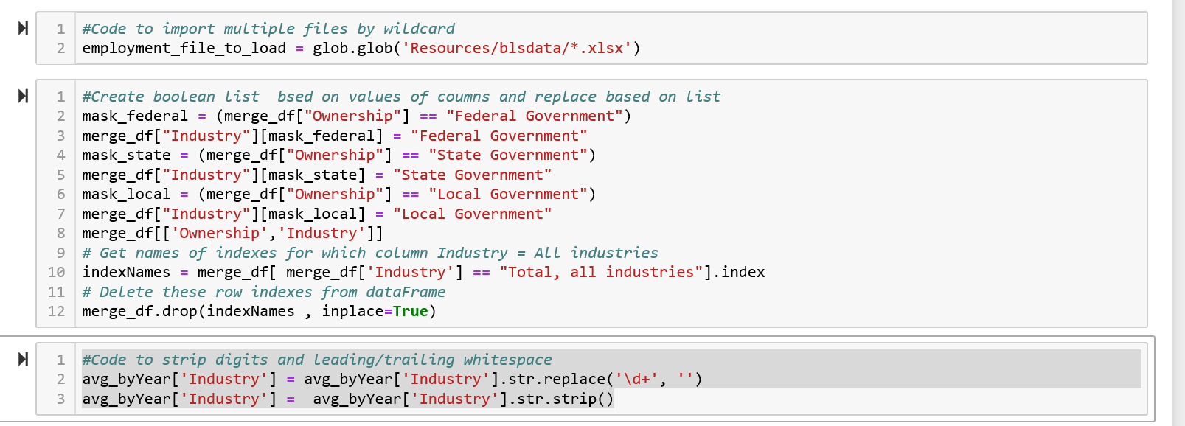

Simple Coding Tools/ Lessons Learned
Run Operations on Panda Data frames as vectorized operations vs looping whenever possible.

Slide 7
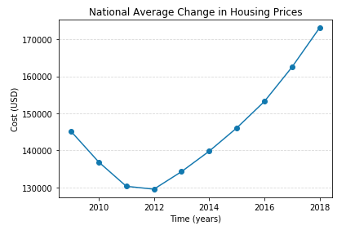
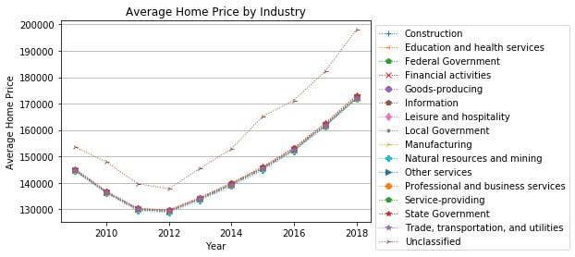
Overhead View
Notes:
Not sure why this was cut off
Overhead view
This is examining national change in hosing prices and by industry specific. Here it shows the unclassified industry trends far higher than the other industries. (Spies and soon to be Donald Trumps taxes)

Slide 8
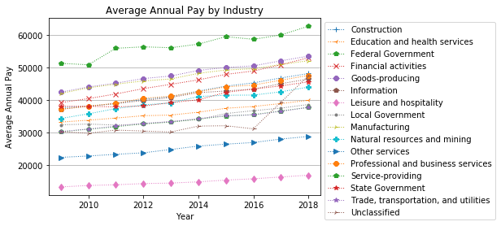

Slide 9
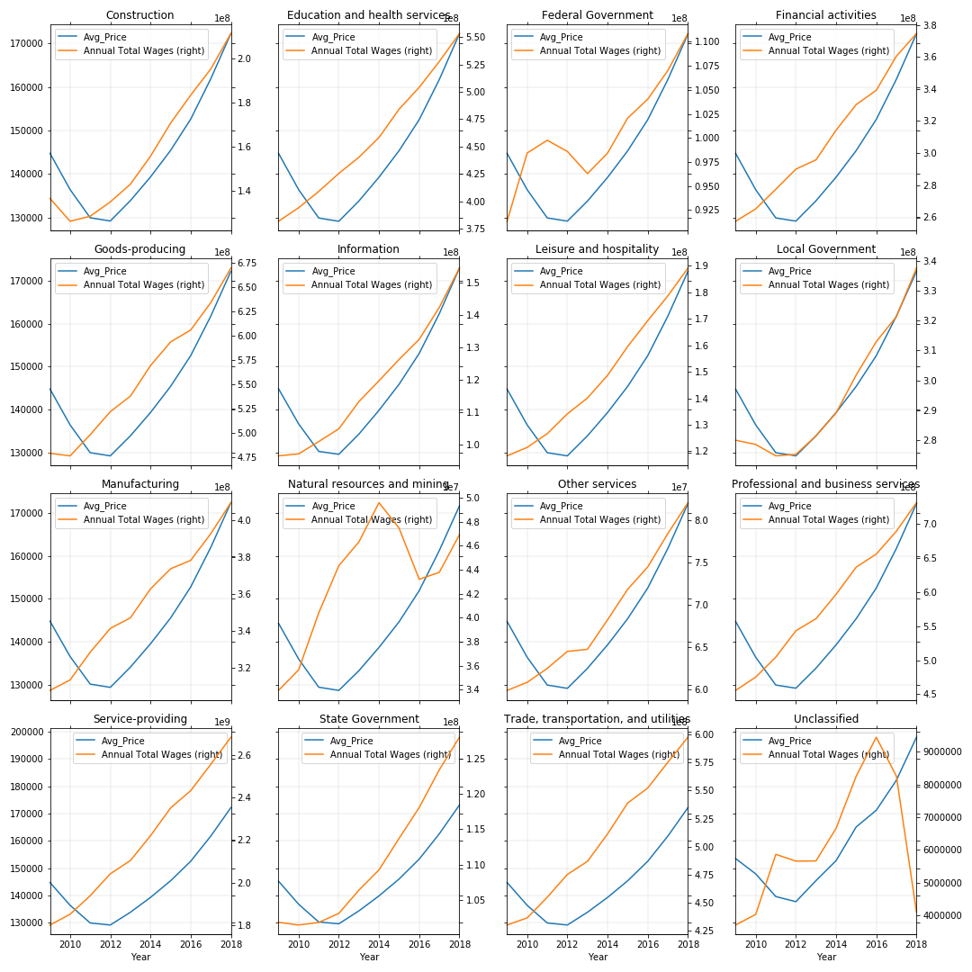
Avg. Mkt. Price vs. Total Wages
Notes:
Price Wages by Industry Wages
Pull legends and put on their own. CHANGE THE SCALES, LABEL THE X for all
Housing prices segmented by industry. Unclassified took a hit in 2016 by wages.
They are all going up except Unclassifed. Probably all those yearly shutdowns.
Local government is entirely on trend with the housing market. It makes sense for local government employees to be able to afford to live locally.
Housing market peaked 2007-2009, crashed 2012
Avg Annual Pay Change

Slide 10
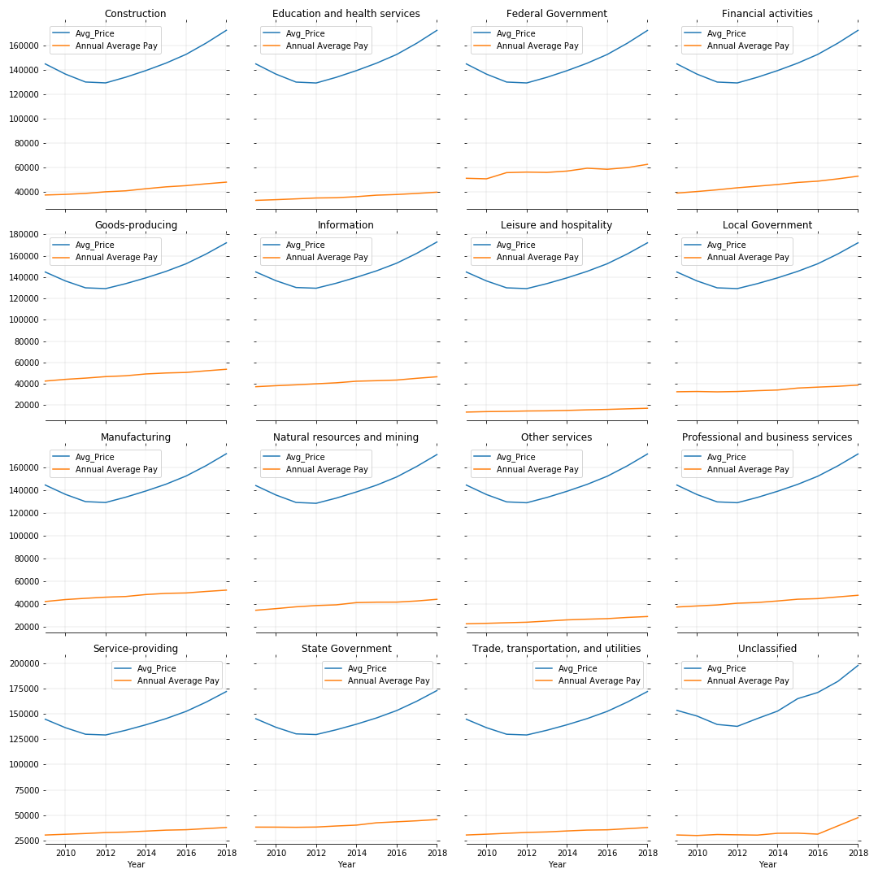
Avg. Mkt. Price vs. Annual average Pay
Notes:
Price Pay by Industry

Slide 11
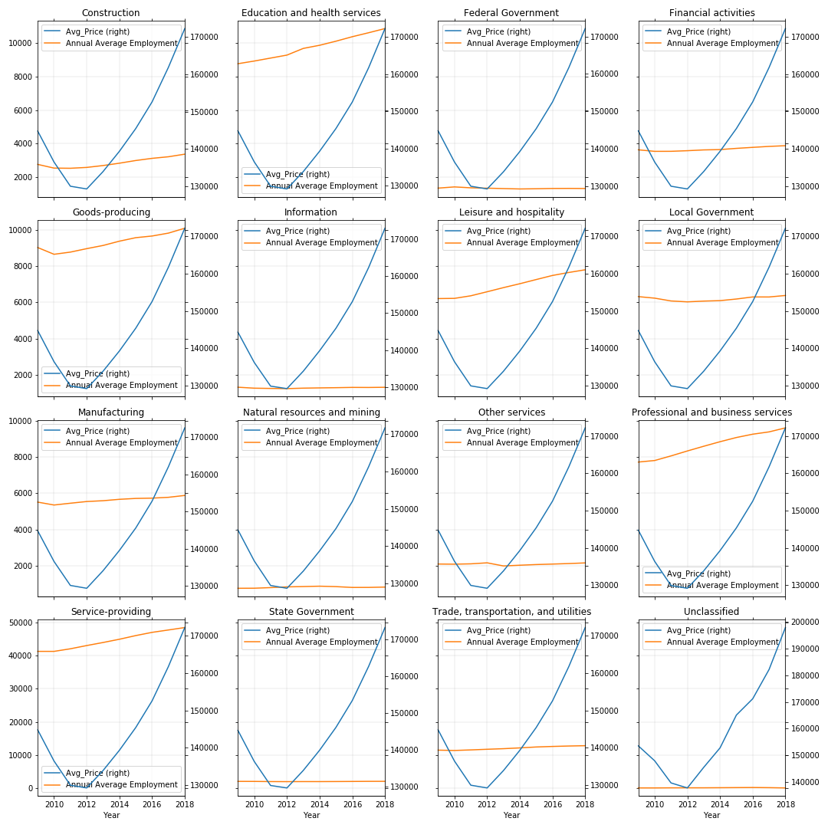
Avg. mkt. price vs. Number of Jobs
Notes:
Price Employment by Industry
Many of the Industries kept the same number of jobs while salary increased, the other industries that appear to have had some increase in the number of jobs did not increase by much.
Wages really increased while the housing market steadily rose
There doesn’t seem to be a relationship

Slide 12
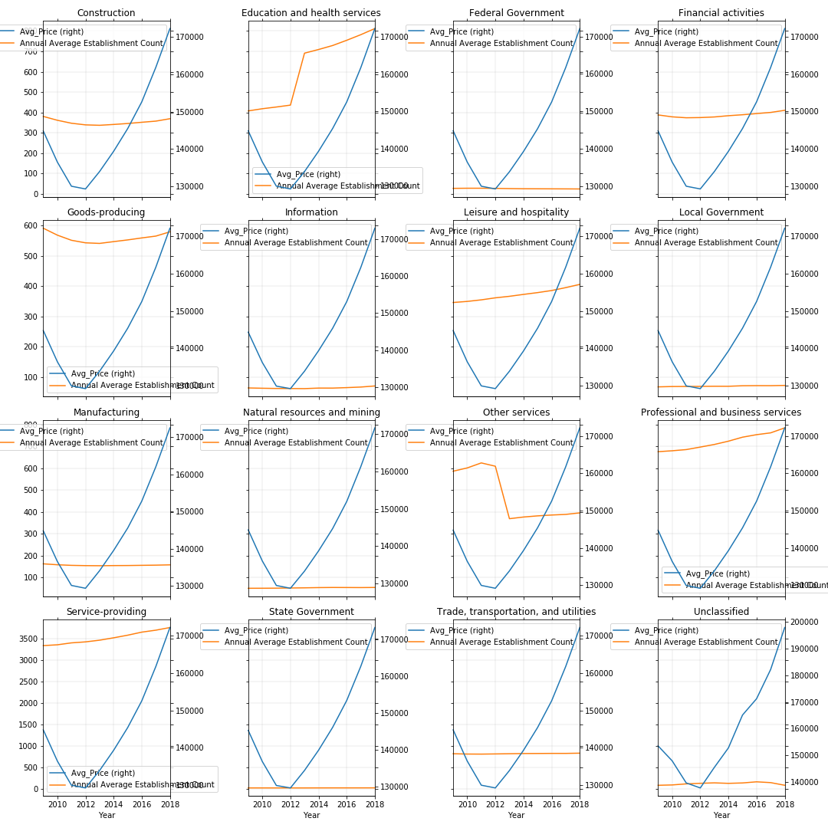
AVG. MKT. PRICE VS. Number of Est.
Notes:
Price Est by Industry
The number of “buisnesses” in those industries? Seems to have had the greatest correlation with Education and Health Services.
However other services drops drastically around similar time as the housing prices dropped. This could be an after affect of the housing market low, because before and after it seems to be a slow and steady increase.

Slide 14
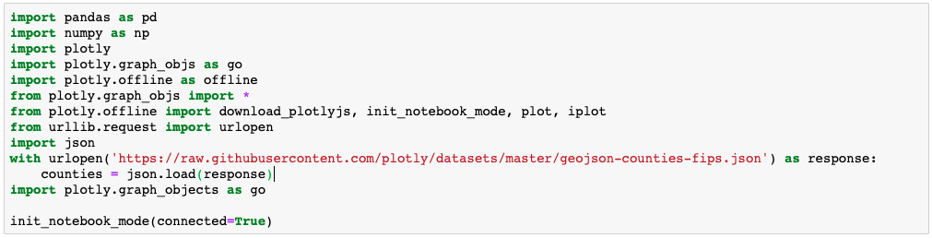
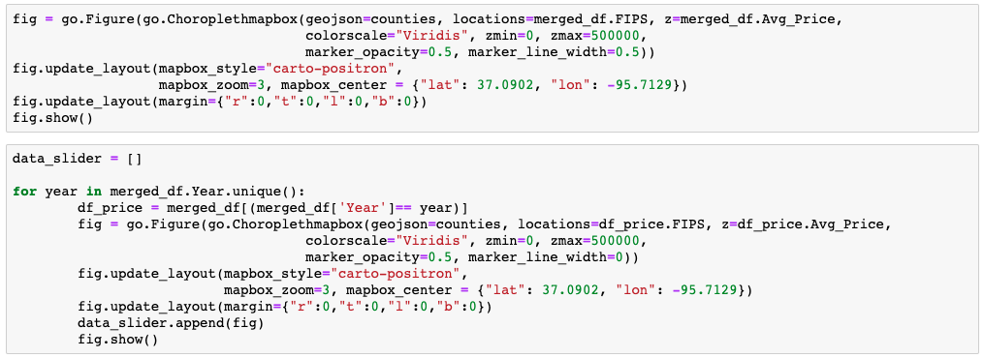

Slide 15
Conclussions
Unclassified!
No relationship between number of jobs and average housing market prices as it pertains to any one industry
Overall nationally we did not see any clear driving force by an industry
It appears that the number of establishments changed in some industries but the number of jobs in that industry did not see the same change
Yes as total wages and annual average pay goes up the housing market prices have gone up
Our data overall leaned more towards national data, which showed a relationship between average annual pay and the average housing market
Notes:
Discussion
Discuss your findings. Did you find what you expected to find?
If not why?
What inferences or general conclusions can you draw from your analysis?

Slide 16
Going Forward
Local level – Counties
Charts/Maps
Looking at changes in underdeveloped neighborhoods
Pull from Twitter API about housing market
Go deeper to into the statistics
Notes:
Post Mortem
Discuss any difficulties that arose, and how you dealt with them
Discuss any additional questions that came up, but which you didn’t have time to answer: What would you research next, if you had two more weeks?

Slide 17
Organizational Lessons Learned
We learned as much from process or lack of as from the data
Coordinating an analysis project amongst 5 people with full time jobs is difficult
Should have worked more on git usage and structure and tested for all users initially, use GIT as intended
The project had natural breakouts of work (data analysis/cleaning, visualization, presentation)
We should have spent more time developing specific questions we wanted to answer and assign them to avoid duplicating work
It is easy to miss inconsistent/edge cases in data that throw off analysis, spend more time validating data

Slide 18
WORKS CITED
Zillow API
Department of Labor API
Census API

